Slide 1

Field Service Management System for Price Heating & Air
Hayden Duran, Jacob Fielder, Samuel Senecal

Slide 2
Outline
Section 1 - Problem Statement & Feasibility Study
Current Field Service Management system in use at Price H&A and it's problems
Our solution and the feasibility of the new system
Section 2 - Review of Requirements Analysis and Specification
Brief review of the new system's functional, operational, and maintenance requirements
Section 3 - Preliminary Design
Brief review of the system of interest and the environment it will operate in
Section 4 - Detailed Design
Application components and scope of the system
Section 5 - Project Management
Calculations on net present value, payback period, and return on investment
Section 6 - Prototype Mockup
Visual examples of the new system

Slide 3
Section 1 - Problem Statement
Current System: Price Heating and Air currently uses a field service management (FSM) system called Sera Software. Sera Software is designed with HVAC companies in mind to provide them with various services to help business operations. Sera’s services help Price Heating and Air identify efficiency gaps, manage scheduling and dispatching, and optimize their workflow all within the one service.
Current System Issues
Offline Tracking Failure: Despite promising offline service call logging, technicians must manually log time and status when out of cell range.
Additional Costs: Due to tracking failures, Price pays for a separate service to monitor technician activity.
Poor User Interface: Confusing layout and hidden functions slow down users and delay critical actions.
Inefficient Call Management: Technicians must navigate multiple pages just to cancel a service call.
Overall Impact: Price is paying for software that hinders efficiency and fails to deliver on key promised features.

Slide 4
Section 1 - Feasibility Study
Economic
Developing an in-house FSM system will cut subscription costs and boost productivity.
Costs: Dev – $20,000 | Cloud – $5,000/yr | Training – $3,500
Savings: $9,000/year (no SERA subscription)
Breakeven: ~2.5 years
Long-term financial gain expected.
Technical
System will run on cloud infrastructure (same as current setup).
Secure database and web interface for staff and technicians
Minimal IT staffing required post-deployment
Main risks: user/cloud training needs

Slide 5
Section 1 - Feasibility Study
Operational
Addresses SERA's UI inefficiencies and user frustration.
Enhanced user experience, modern UI
Integrates with current timekeeping
Smooth transition anticipated
Legal
Ensure compliance with data protection regulations
License any dev tools used
Terminate SERA subscription responsibly and transfer data securely
Time
Estimated timeline: 6 months
Milestone-based planning
Strategic resource allocation to ensure timely delivery

Slide 6
Section 2 - System Requirements
Functional
Technicians, dispatchers, and admins can view, modify, and manage job data.
Logs key info: service type, hours, customer details, job location, and staff assignments.
Supports ticket creation, updates, acceptance, and customer lookups.
Built with MySQL database integrated into a secure, role-based web application.
Operational
Development budget: ≤ $20,000
Annual cloud hosting cost: ≤ $5,500
Maintenance
99.5% annual uptime (≈ 45 hrs/year downtime allowed)
Auto-checks and installs software updates
Cloud-hosted only; no on-site hardware required
Maintained by existing IT staff

Slide 7
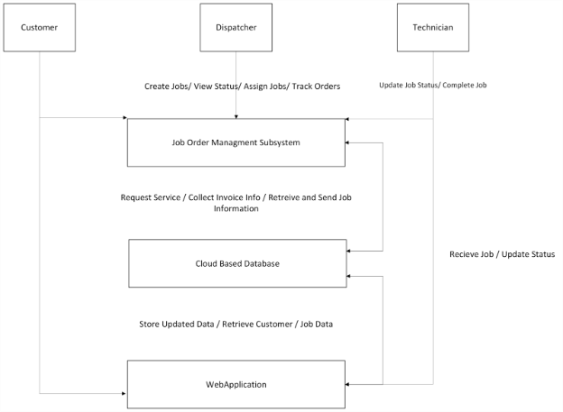
Section 3 - Preliminary Design
System of Interest
This system will help manage job orders, schedule and dispatch technicians efficiently, and provide real-time information to service technicians and dispatchers.
This system will consist of three main subsystems designed to streamline service operations:
Job Order Management Application – Handles job scheduling, tracking, and completion
Cloud-Based Database – Securely stores all job orders, customer records, technician schedules, and invoices
Web Application – Serves as the primary interface/GUI for technicians and dispatchers

Slide 8
Section 3 - Preliminary Design
System Environment
This system will be deployed on the Google Cloud Platform (GCP) providing scalable, secure, and cloud-native infrastructure.
Will be accessible on a wide range of operating systems including Windows, iOS, Android.
Will ensure compatibility for both onsite and offsite devices (Desktop PC's and mobile devices).
The FSM will integrate with the organization’s existing Identity and Access Management (IAM) system to provide secure, role-based authentication across all platforms.
Data synchronization will occur instantly across all user touchpoints, allowing seamless coordination between mobile users in the field and desktop users at headquarters.
The system will also support integration with external systems via APIs for email notifications, cloud file storage (ex. Google Drive), and potential CRM or analytics platforms.

Slide 9
Section 4 - Detailed Design
Application Components
The FSM system is built on three main components:
a cloud database
a web app
a hosting server
While infrastructure is purchased, all software and environments are developed in-house.
Core design elements include:
User Interface
Authentication & Authorization
Device Integration
Data Storage
Security Layer & Integration APIs
Size & Scope
In Scope:
Manage customer job orders (date, location, issue)
Dispatcher job assignment by skill/availability
Technician job updates and service notes
Invoice and report generation/storage
Out of Scope:
Payroll and HR functions
Real time GPS tracking
Full CRM features
Customer access to the system

Slide 10
Section 4 - Detailed Design
Programming Languages
Job Order Management App: Developed in C# using the .NET framework for Windows-based workstations.
Web Application: Built with Django (Python), using HTML, CSS, JavaScript, and JSON for API interactions. Chosen for its simplicity and cost-effectiveness.
Database: Uses PostgreSQL, a robust open-source RDBMS. Supports both standard SQL and efficient JSON data handling and integrates well with Django.

Slide 11
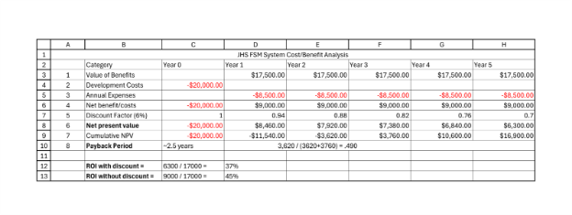
Section 5 - Project Management

Slide 12
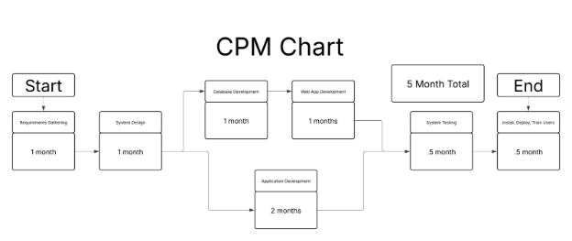
Section 5 - Project Management

Slide 13
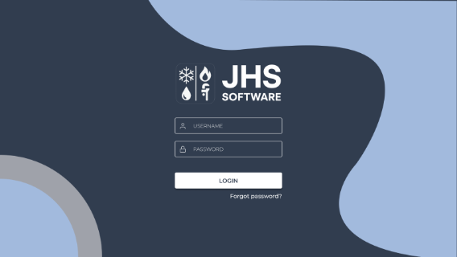
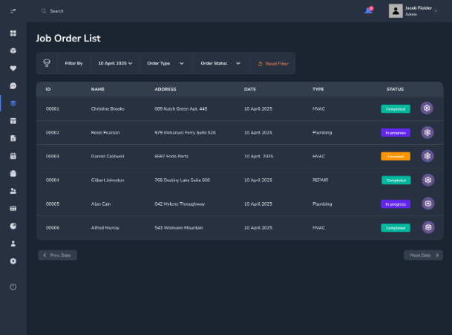
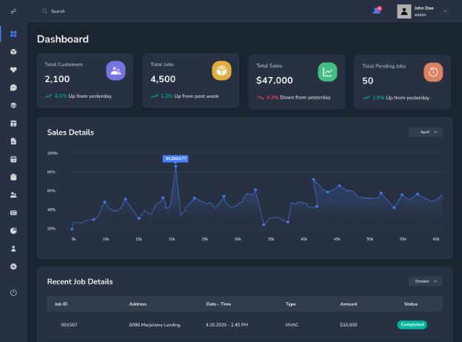
Section 6 - Prototype Mockup
JHS Login Page A - This page contains boxes that request a user for their login credentials, and login button, and a forgotten password selector if the user has forgotten their password.
Dashboard Page B - This is the Dashboard page that displays important metrics like sales details and recent job details. The user is also able to navigate to different pages by using the left side vertical menu.
Job Order List Page C – Users can sort previous and current jobs by using the filter at the top of the page. This page shows customer information and gives an option to edit the job with the gear icon to the far right.

Slide 14
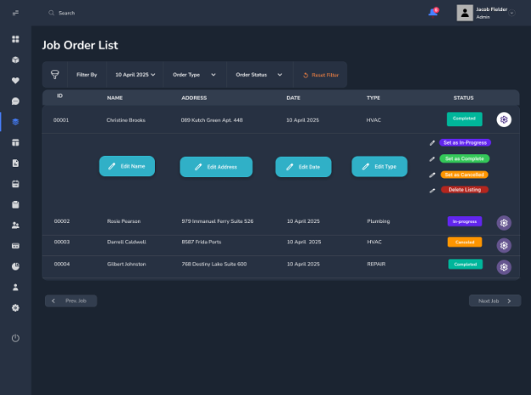
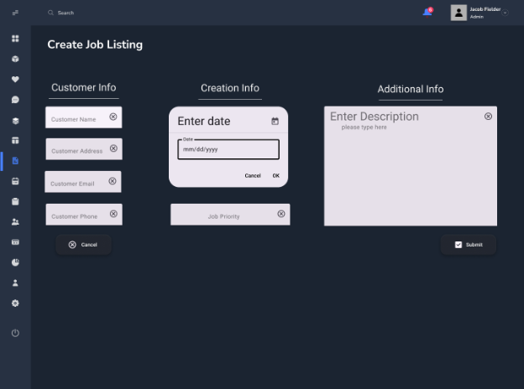
Section 6 - Prototype Mockup
Job Order List Expanded Page D - Users can expand the list using the gear icon and edit the selected job’s details, status, etc.
Create Job Listing Page E – Users can input information gathered from customer phone calls and email requests to create a new job listing. Users will put in general customer information as well as discern job priorities and provide unique information through use of the description box.

Slide 15
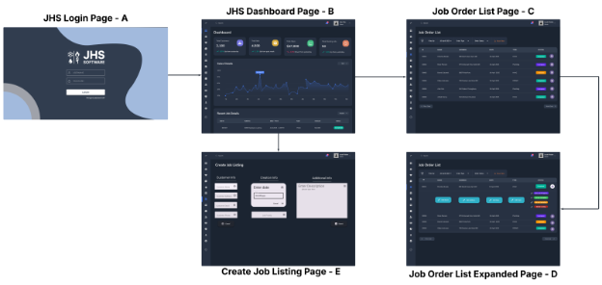
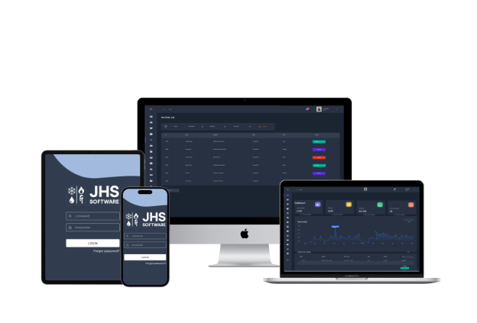
Section 6 - Prototype Mockup
This is an example of what our final prototype would look like on stationery and mobile devices. The mockups include a desktop computer, a laptop, a tablet, and a smartphone.
Prototype Flowchart

Slide 16
Closing
Thank you
Questions?

